Slide 1
Ethnic identity and Nation-building in Kyrgyzstan
Damirnjav Bayarta

Slide 2
Introduction
In my Master’s thesis I worked on investigating the historic origin and current situation of the Karakul Kalmyks in the Kyrgyz Republic, where I did my fieldwork. I noticed that the Karakul Kalmyk identity has changed and transformed during the nation building and statehood formation of Kyrgyzstan. Previously, they tended to identify as Kalmyks , but recently they are increasingly identifying more with Kyrgyz,Mongol,Torguud,Ulud and other ethnicities.

Slide 3
My research examined the daily life of people in rural communities, to form a better understanding of how they define themselves and what ethnic categories they use to talk about themselves. After that, I analyzed how their identity and words are reflected in their own cultural and ethnic concepts. My Master thesis is mainly composed of three chapters. The first chapter describes the historical origin, population distribution and cultural characteristic of Karakul Kalmyks. The second chapter addresses the social organization of local ethnic groups neighboring with Karakul Kalmyks. The third chapter is mainly about the identity transformation of the Karakul Kalmyk people during the construction of the nation of Kyrgyzstan.

Slide 4
1.historical origin, population distribution and cultural characteristic
describes the historical origin, population distribution and cultural characteristic of Karakul Kalmyks.
the concepts of “Kalmyk”, “Kalmak” and “Sart-Kalmak” overlapped most of the time and referred to a group of Western Mongol or Oirat origin that migrated from the territory of modern Xinjiang, particularly from the Tekes area, approximately in the 1880s.（Burdukou）

Slide 5
Map of Karakol

Slide 6
population
1.Kara-kol;
2.Chelpek;
3.Burma-suu;
4.Tash-keya;
5.Buru-bash;

Slide 7
They are Sunnis of Islam.
Their language belongs to the Altai Mongolian family, but now they use Kyrgyz and Russian in their lives.

Slide 8
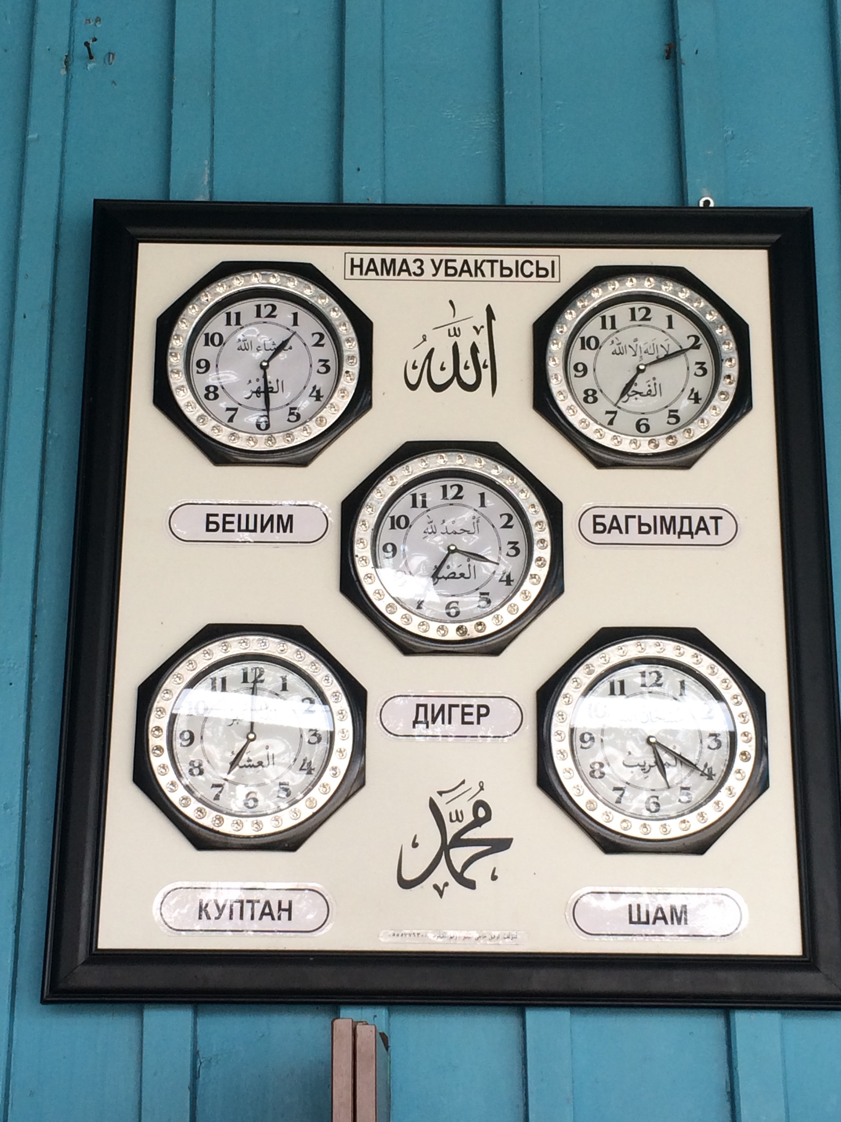

Slide 9
Islam practice

Slide 10
2.social organization
There are 14 (15) tribes in the Kalmyk people of Karakul. The Bayin-bakh and Kara-batyr tribes inside are what they consider to be the real Kalmyk tribes.
Their social organization is different from the 40 tribes in Kyrgyzstan and is the source of their identity.

Slide 11
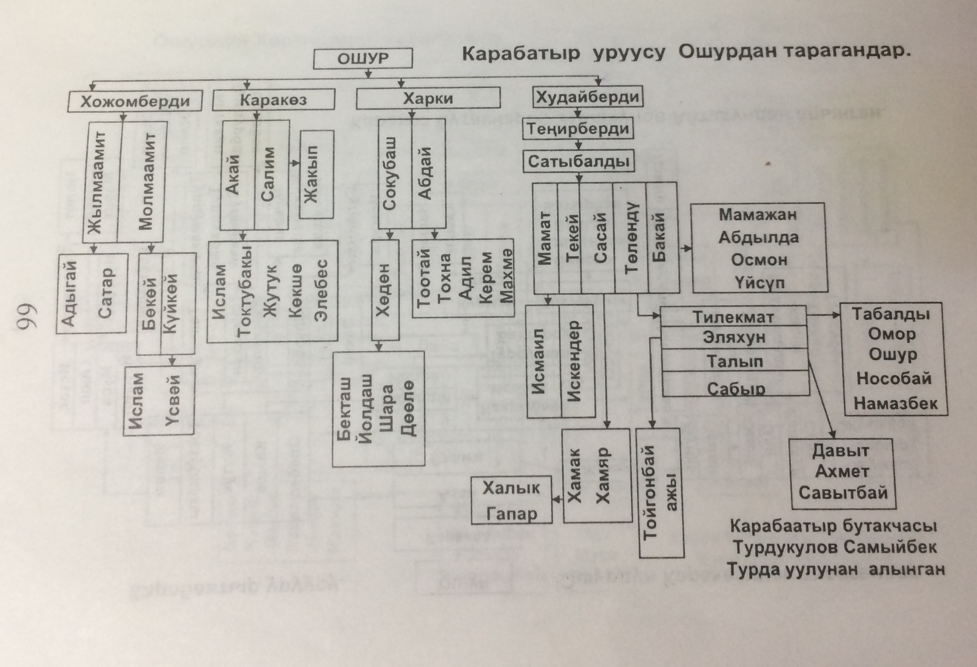
Kalmyk tribe(uruu)

Slide 12
3.identity transformation
Year/Ethnic Groups | kyrgyzstan(nation) | Kalmyks
1991-ago | Sart-Kalmyk | Kalmyk
1991-after | Kalmyk | Mongol,Torguud,Ulud,Kyrgyz...

Slide 13
Nation-building
Manas
40-tribe
kyrgyzstan
Islam
kyrgyz

Slide 14
Nation-building in Kyrgyzstan
Askar Akayev ( President of Kyrgyzstan, 1990-2005)
Manas -1000;
2,200th Anniversary of Kyrgyz Statehood;
40-tribe;

Slide 15
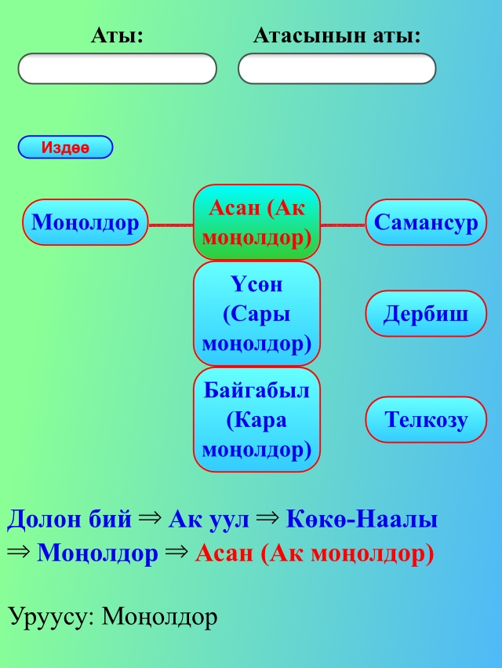

Slide 16
In my research, I noticed that people who consider themselves to be Kalmyk mainly use Kalmyk food, tribal organizations (they are divided into 15 tribes) and Kalmyk language as the basis for identification. They speak Kyrgyz and consider themselves as Kyrgyzstani during national events and anniversaries as well as in the election.

Slide 17
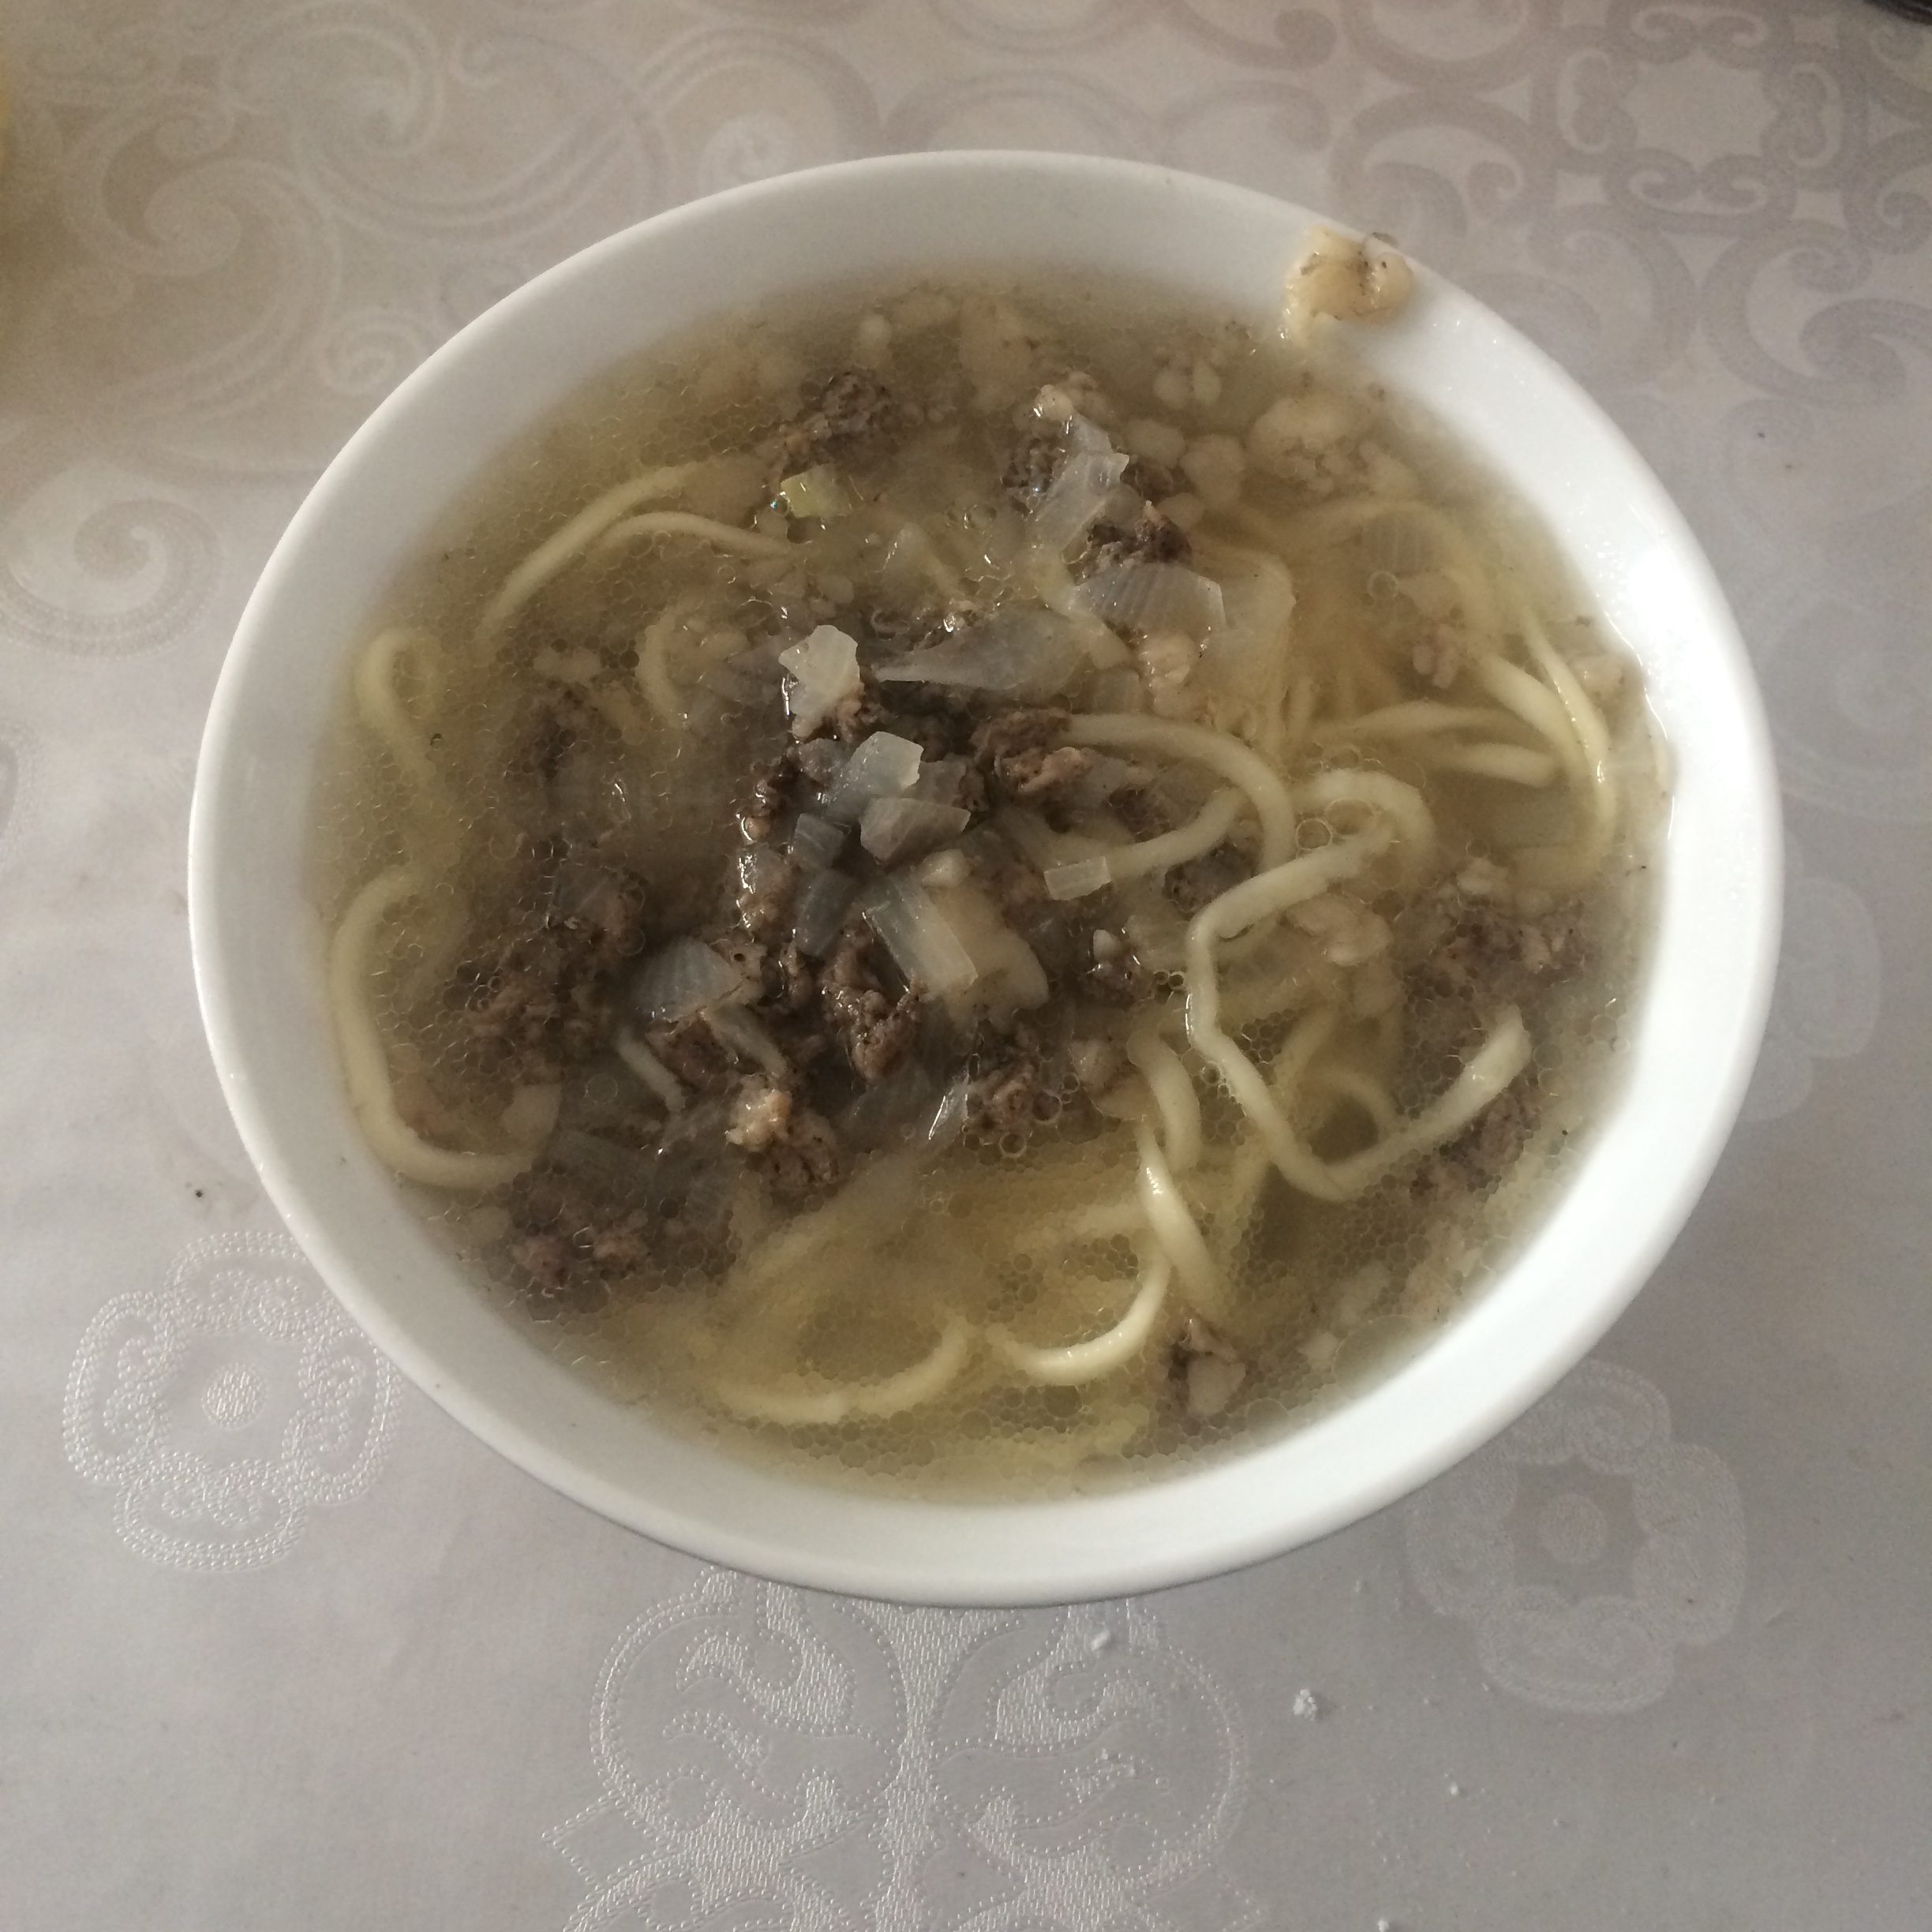
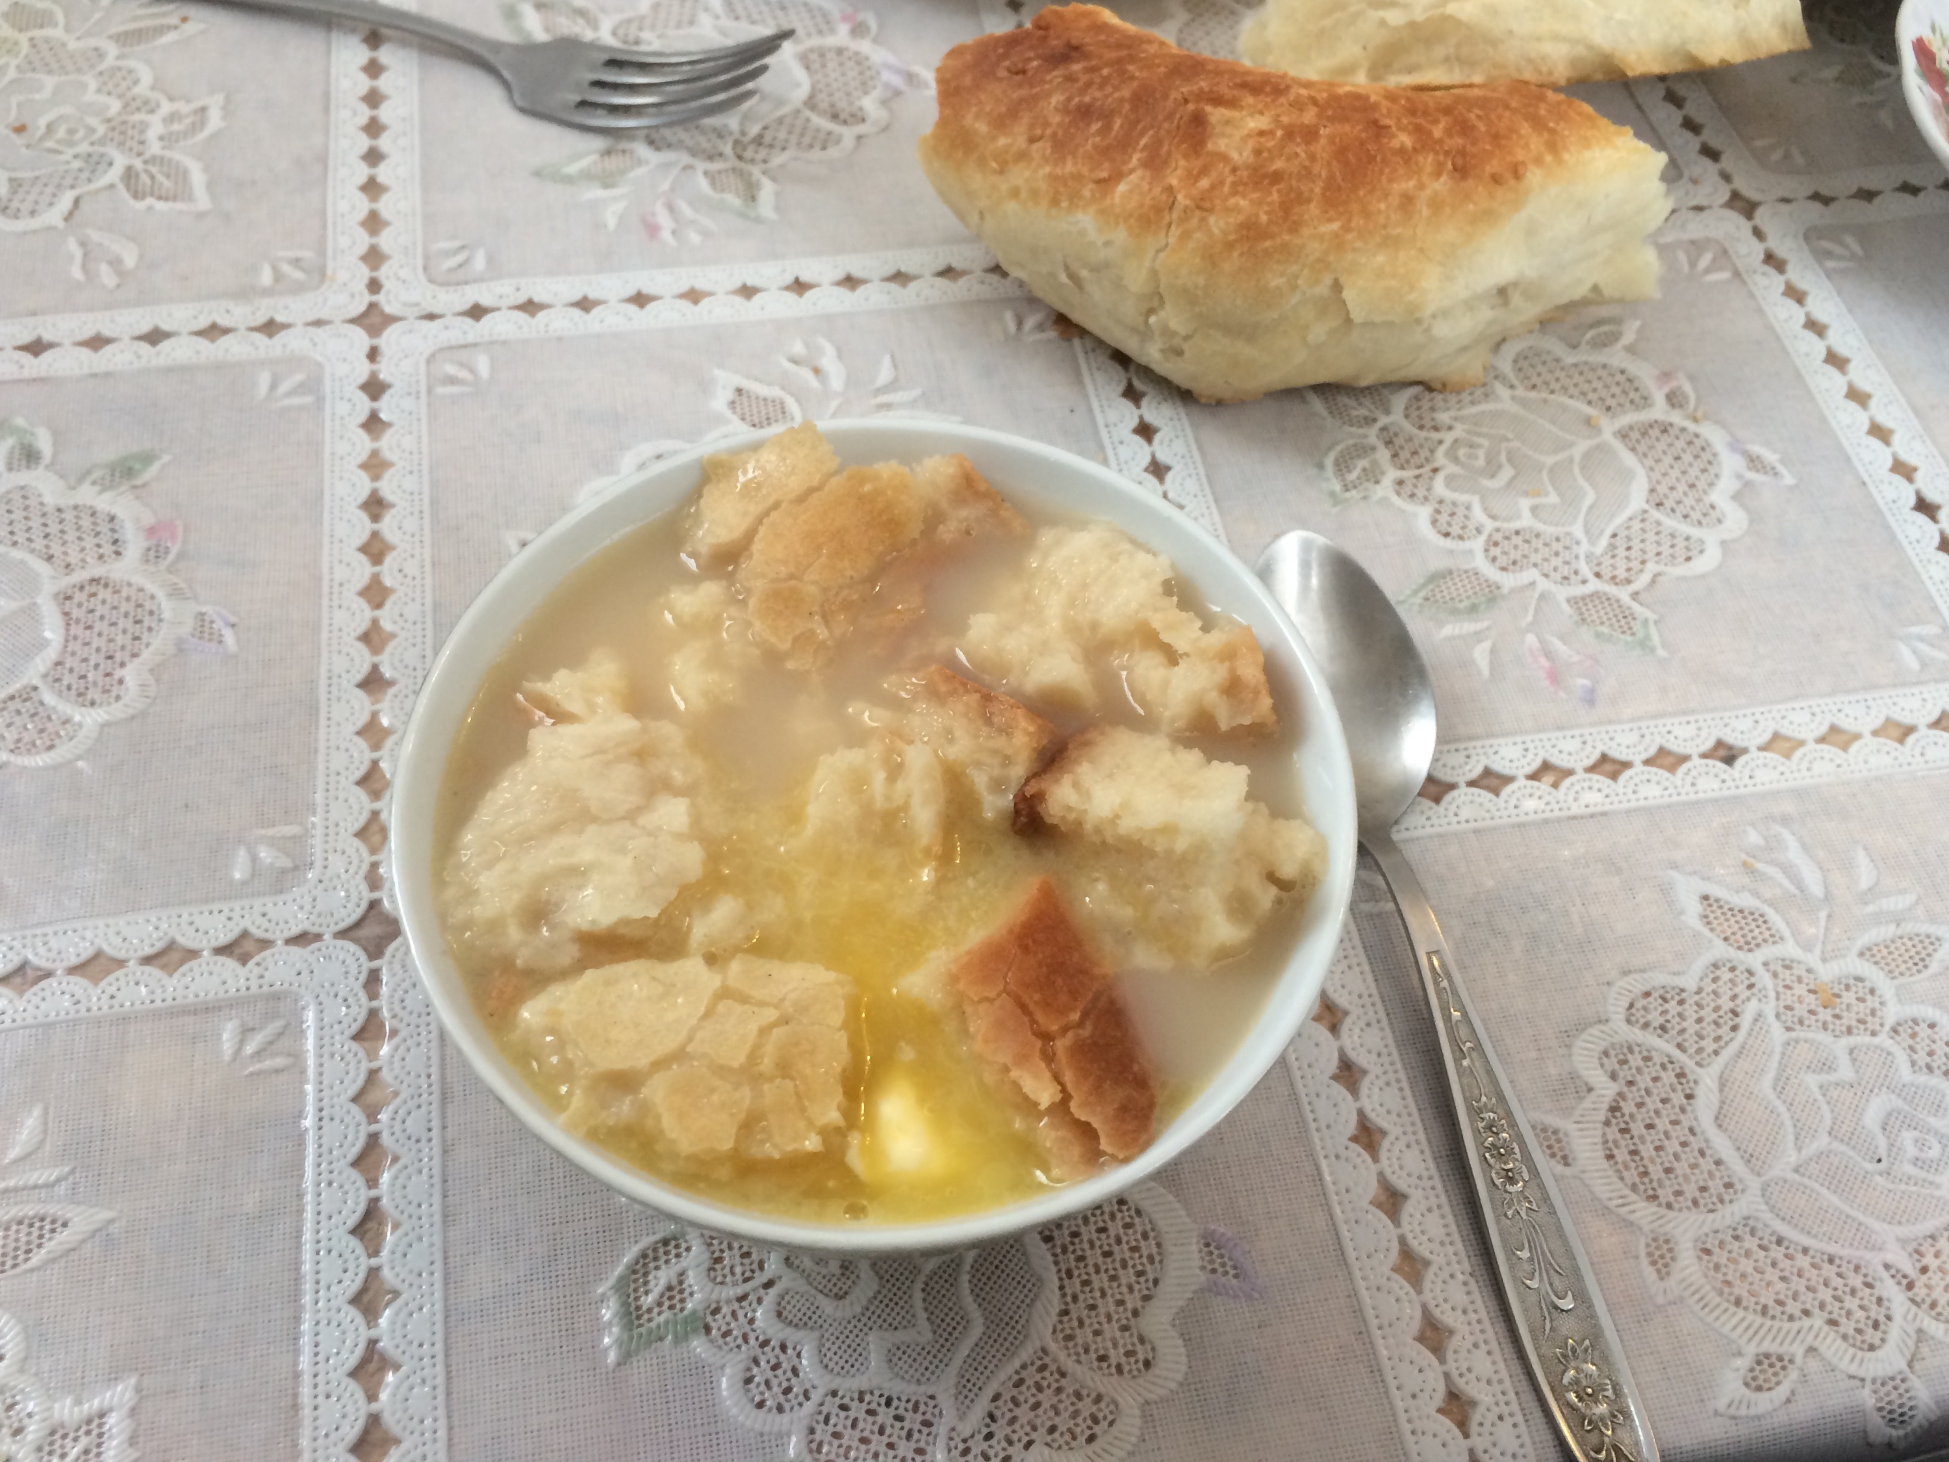
Kalmyk foods

